Slide 1


Analysis Preparation on COVID-19 datasets
Asma Alshahrani

Slide 2

Introduction
In this project, we want to specify the most affected countries in one day, different features, to calculation maximum, minmum , mean for Confirmed,Deaths, Recovered and Active, check missing values,check missing values, Seperate dates to see how many days, how many months, how many years.
The data contains 10 column and 490,69 row.
The data contains the following columns:
1)Province/State
2) Country/Region
3) Lat
4) Long
5) Date
6) Confirmed
7) Deaths
8) Recovered
9) Active
10) WHO Region

Slide 3
The question will disscuse about it in the data is:
- What is the Maximum,Minimum,median for the Confirmed,Deaths,Recovered, Active?
- Comaper between Deaths and Active?
- How many the Total Corona Virus Active vs Recovered؟

Slide 4
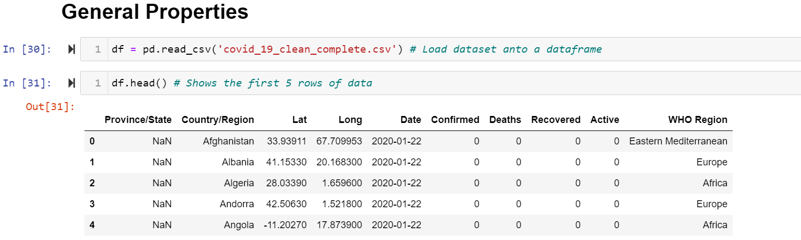

Slide 5
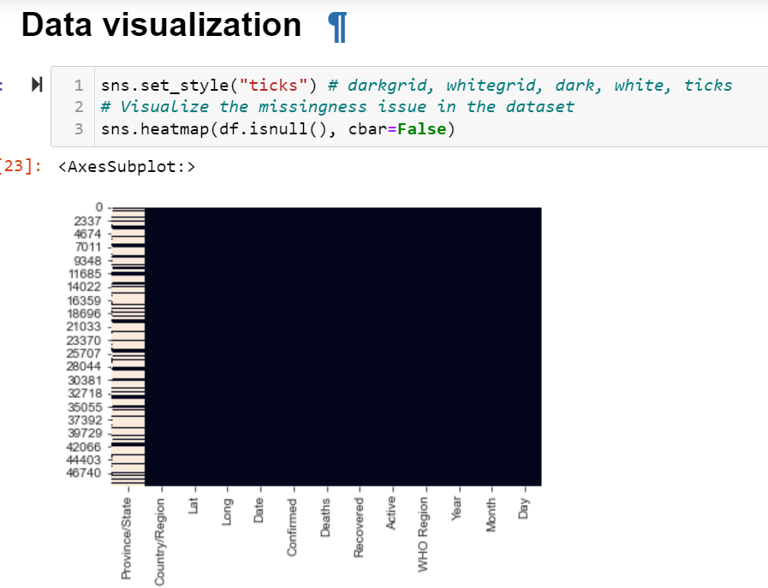
Visualize the missingness issue in the dataset

Slide 6
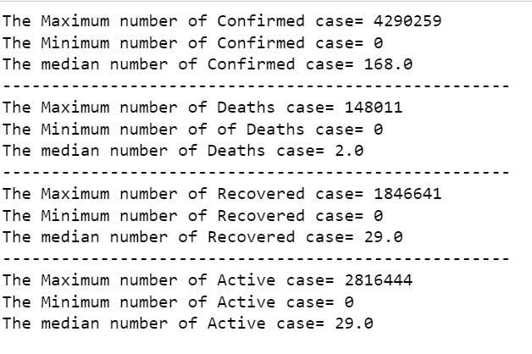
What is the Maximum,Minimum,median for the Confirmed,Deaths,Recovered, Active?

Slide 7
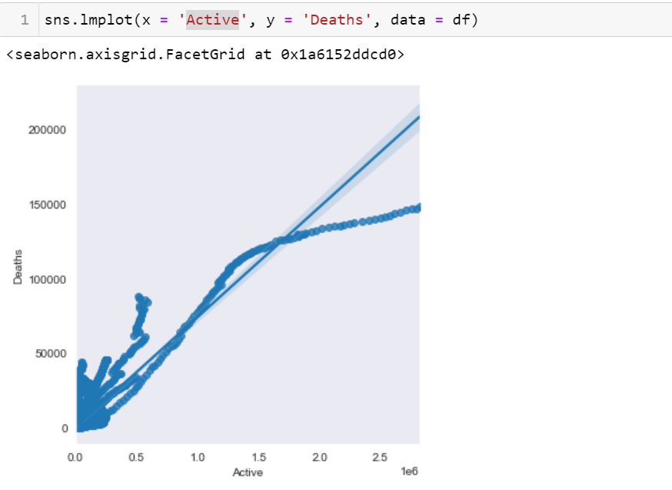
Comaper between Deaths and Active?

Slide 8
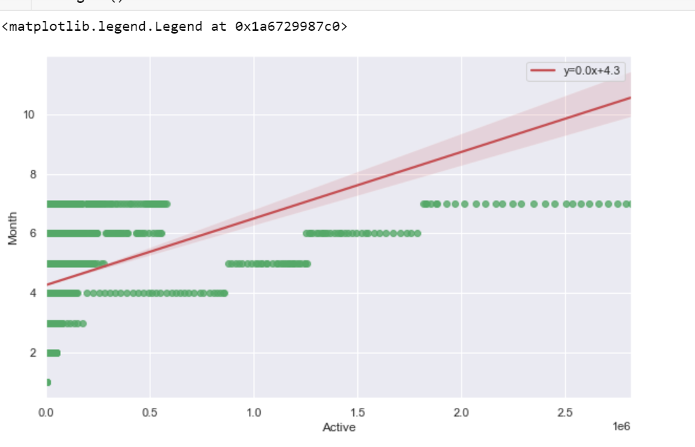
Import LinearRegression from sklearn.linear_model
This model will help to predict active case of the COVID-19 per month

